Slide 1
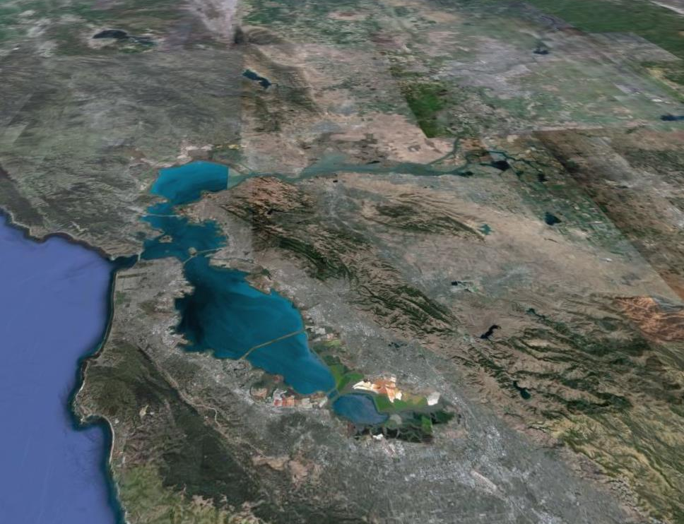

Estuarine Nutrient Numeric Endpoint
San Francisco Bay Stakeholder Advisory Group (SF Bay SAG) Meeting
May 20, 2011, 10-3:30

Slide 2
Context for Today’s Meeting
SWRCB is Developing Nutrient Objectives for California Waterbodies
Completed nutrient numeric endpoint (NNE) framework for streams & lakes (EPA 2006)
Conceptual approach and work plan drafted for NNE development in California estuaries (EPA 2008)
In 2008, SWRCB staff initiated a project to develop NNE framework for estuaries
  Scope of effort called for literature review and work plan specific for San Francisco Bay
Notes:
Rik

Slide 3
NNE In San Francisco Bay:
Where is This Going??
NNE Literature Review and Data Gaps Analysis
NNE Workplan
NNE Assessment Framework
Load-Response Models
Notes:
Rik

Slide 4
Developing NNE Workplan for SF Bay-Process
Science
Form technical team
Review literature on use of NNE candidate indicators in SF Bay
Identify “promising” indicators, data gaps and recommended next steps
Stakeholders
Form SF Bay SAG
Review NNE framework & background documents
Provide feedback on literature review, data gaps and prioritize next steps
NNE Workplan for SF Bay
Notes:
RIK

Slide 5
Timeframe for Work Plan Development
SF Bay NNE Workgroup
SF Bay RMP Nutrient Strategy
Draft lit. review
SAG feedback
Finalize lit. review
Outline of workplan
Draft workplan
Final workplan
April 2011
June 2011
Aug 2011
Oct 2011
Dec2011
RMP Nutrient Strategy Workshop
RMP Nutrient Strategy meetings
Draft RMP Nutrient Strategy

Slide 6
Process to Develop NNE Workplan for SF Bay
Specify geographic scope and habitat types included
Develop conceptual models and ID candidate indicators
Review utility of indicators vis-à-vis evaluation criteria
Identify data gaps and recommended next steps to:
    Develop diagnostic framework and select endpoints
    Develop load-response models
Work plan – Consensus on prioritized steps to develop NNE

Slide 7
SF Bay Technical Advisory Team Members
Jim Cloern (USGS)
Richard Dugdale (SFSU)
Raphael Kudela (UC Santa Cruz)
Katharyn Boyer (SFSU)
Notes:
Rik

Slide 8
Recap of Last Meeting
Discussed NNE conceptual framework
Discussed criteria for selection of NNE indicators for SF Bay
Stakeholders provided feedback on preliminary list of NNE indicators used for review
Notes:
RIK

Slide 9
Meeting Goals
Agree on criteria for selection of Science Advisory Panel members and provide feedback on candidates
Solicit SAG feedback on SF Bay NNE literature review and data gaps report
Solicit SAG input on scope of SF Bay NNE workplan
Notes:
RIK

Slide 10
Project Organization- SF Bay
SF Bay SAG
State Water Resources Control Board (SWRCB)
SF RWQCB
STRTAG
Science Advisory
SF Bay Technical Team
Panel (SAP)
Notes:
RIK__--Take some time to summarize how the SF Bay effort is organized—the main player within the STRTAG is SF RWQCB, but STRTAG will be looking on to ensure consistency with statewide effort. Give Naomi a couple minutes to make remarks if she’d like.
The SF Bay SAG will be lead by Brock Bernstein as the facilitator and spokesperson of the group.
The SF Technical Team will be lead by SFEI, with SCCWRP participating to ensure technical consistency.
The Science Advisory Board will provide peer review of the SF Bay Tech Team’s effort.

Slide 11
Context for Today’s Discussion on Science Advisory Panel
At the last meeting, you asked if the SF Bay literature review would receive external peer review
The answer is yes…
  Science Advisory Panel will be the same for both SF Bay and rest of the California’s estuaries
  Intent is to form SAP this summer, convene them this fall to review estuarine NNE products
Notes:
RIK

Slide 12
Process for Candidate SAP Member Selection
Determine desirable attributes of SAP panel members
Technical Team lead (SCCWRP) nominates candidates
STRTAG and SAGs (Coastal and SF Bay) review candidates and have right to reject individual candidates
SWRCB makes final decision
We have not contacted these candidates yet…
Notes:
Steve –The Science Advisory Board will operate independently from the Technical team and will review adequecy of science and how it is used in policy. The Science Advisory Board will be composed of 3-4 nationally recognized experts. Formation of the Board will occur in the springtime, timed with delivery of technical products to review.

Slide 13
Suggested Criteria for SAP Members
Nationally-recognized expert in one of following:
  Aquatic ecosystem response to nutrient overenrichment and eutrophication
  Experience in development, validation and use of watershed loading and/or estuarine water quality models
  Experience in creation of nutrient-related water quality objectives or criteria
Not affiliated with California-based institution
What do you think you of these criteria?
Notes:
Steve –The Science Advisory Board will operate independently from the Technical team and will review adequecy of science and how it is used in policy. The Science Advisory Board will be composed of 3-4 nationally recognized experts. Formation of the Board will occur in the springtime, timed with delivery of technical products to review.

Slide 14
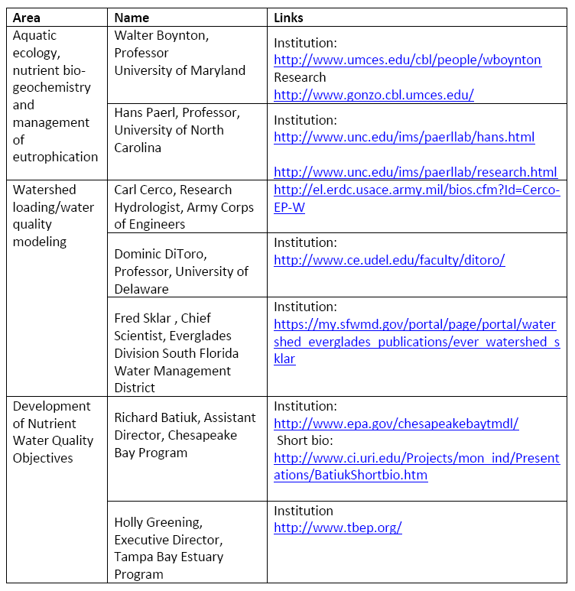
Discussion of Candidate SAB Members:
Aquatic Ecology, Nutrient Biogeochemistry, and Management of Eutrophication
Do you have any concerns about either candidates?
Notes:
Steve –The Science Advisory Board will operate independently from the Technical team and will review adequecy of science and how it is used in policy. The Science Advisory Board will be composed of 3-4 nationally recognized experts. Formation of the Board will occur in the springtime, timed with delivery of technical products to review.

Slide 15
Discussion of Candidate SAB Members:
Development/Application of Dynamic Simulation Models
Do you have any concerns about either candidates?
Notes:
Steve –The Science Advisory Board will operate independently from the Technical team and will review adequecy of science and how it is used in policy. The Science Advisory Board will be composed of 3-4 nationally recognized experts. Formation of the Board will occur in the springtime, timed with delivery of technical products to review.

Slide 16
Discussion of Candidate SAB Members:
Development of Nutrient-Related Water Quality Objectives
Do you have any concerns about either candidates?
Notes:
Steve –The Science Advisory Board will operate independently from the Technical team and will review adequecy of science and how it is used in policy. The Science Advisory Board will be composed of 3-4 nationally recognized experts. Formation of the Board will occur in the springtime, timed with delivery of technical products to review.

Slide 17
Meeting Goals
Agree on criteria for selection of Science Advisory Panel members and provide feedback on candidates
Solicit SAG feedback on SF Bay NNE literature review and data gaps report
Solicit SAG input on scope of SF Bay NNE workplan
Notes:
RIK

Slide 18
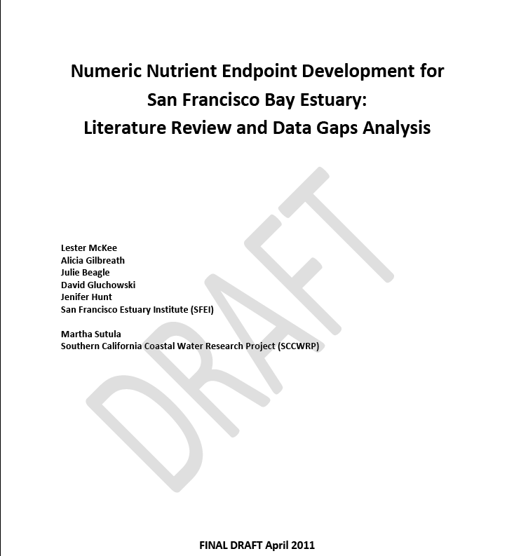
Notes:
Steve –The Science Advisory Board will operate independently from the Technical team and will review adequecy of science and how it is used in policy. The Science Advisory Board will be composed of 3-4 nationally recognized experts. Formation of the Board will occur in the springtime, timed with delivery of technical products to review.

Slide 19
SAG Guidance on Literature Review
Is the review indicators technically accurate?
What do you think about our assessment of whether the candidate indicators meet review criteria?
What do you think about the recommended primary and supporting indicators?
What do you think about our assessment of status and trends of the Bay using these indicators?
What do you think of our assessment of nutrient load data?
What do you think about the data gaps identified and recommended next steps?
Notes:
One of the most take home important messages for today is that nutrient objectives are coming
One source of pressure is the lawsuit settlement that required that EPA develop nutrient criteria for Florida—they retracted Florida’s authority and are in the process of publishing criteria –this year freshwater, next year estuarine
California has actually been working nutrient objectives since 1999, they currently have draft objectives for freshwater habitats prepared for peer review and standards
Locally—we are also seeing that nutrient assessment are being written into Ocean permits—a good example is the hyperion permit..so you are seeing momentum on this issue within state as well as locally

Slide 20
Literature Review Outline
Introduction and Purpose
Background, Conceptual Approach, Candidate NNE indicators, Review Criteria
Geographic Context, SF Bay Beneficial Uses, and Existing Basin Plan Objectives
Nutrient Sources and Ambient Concentrations in SF Bay
Review of Candidate Indicators and Summary of Trends
Synthesis and Data Gaps
Literature Cited
Notes:
One of the most take home important messages for today is that nutrient objectives are coming
One source of pressure is the lawsuit settlement that required that EPA develop nutrient criteria for Florida—they retracted Florida’s authority and are in the process of publishing criteria –this year freshwater, next year estuarine
California has actually been working nutrient objectives since 1999, they currently have draft objectives for freshwater habitats prepared for peer review and standards
Locally—we are also seeing that nutrient assessment are being written into Ocean permits—a good example is the hyperion permit..so you are seeing momentum on this issue within state as well as locally

Slide 21
Review of Candidate Indicators for the Estuarine NNE
Four Questions:
What are the appropriate indicators to assess eutrophication in SF Bay?
What is the status/trends of eutrophication in SF Bay, using these indicators?
What data are available to summarizing nutrient loading to SF Bay?
What are the data gaps and next steps required to develop an NNE framework for SF Bay?

Slide 22
Indicator Review Criteria
Dose – response relationship exists between indicator & higher trophic level (link to beneficial use)
Can develop predictive model between nutrient loads, other co-factors, and ecological response (statistical, spreadsheet, or dynamic simulation models)
Scientifically sound and practical measurement process
Show a detectable trend in eutrophication or other adverse effects from nutrients (signal: noise ratio is acceptable)

Slide 23
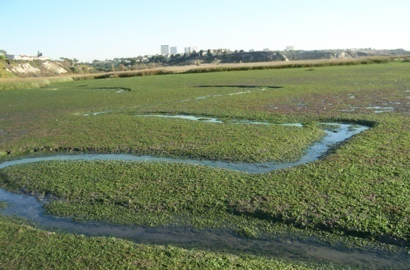
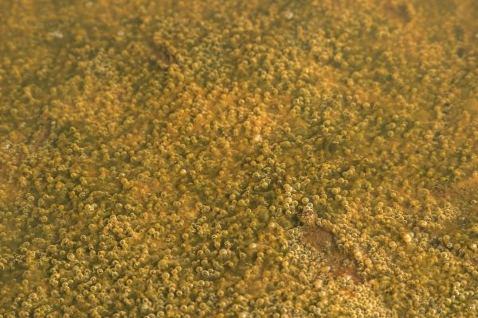
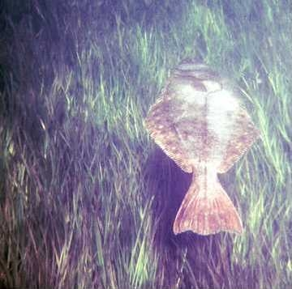
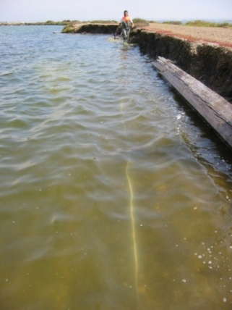
Appropriate Indicators Will Vary By Habitat Type
Depth | Dominant Primary Producers
Intertidal Flats | Microphytobenthos (MPB) Macroalgae
Subtidal | MPB Phytoplankton Macroalgae SAV
Deepwater or Turbid Subtidal | MPB Phytoplankton
Microphytobenthos
(MPB)
Macroalgae
Seagrass/ SAV
Phytoplankton
Notes:
Make less crowded

Slide 24
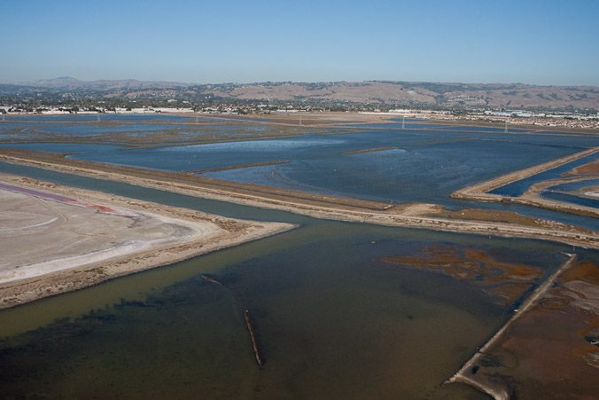
Added Fourth Habitat Type: Tidally Muted Baylands

Slide 25
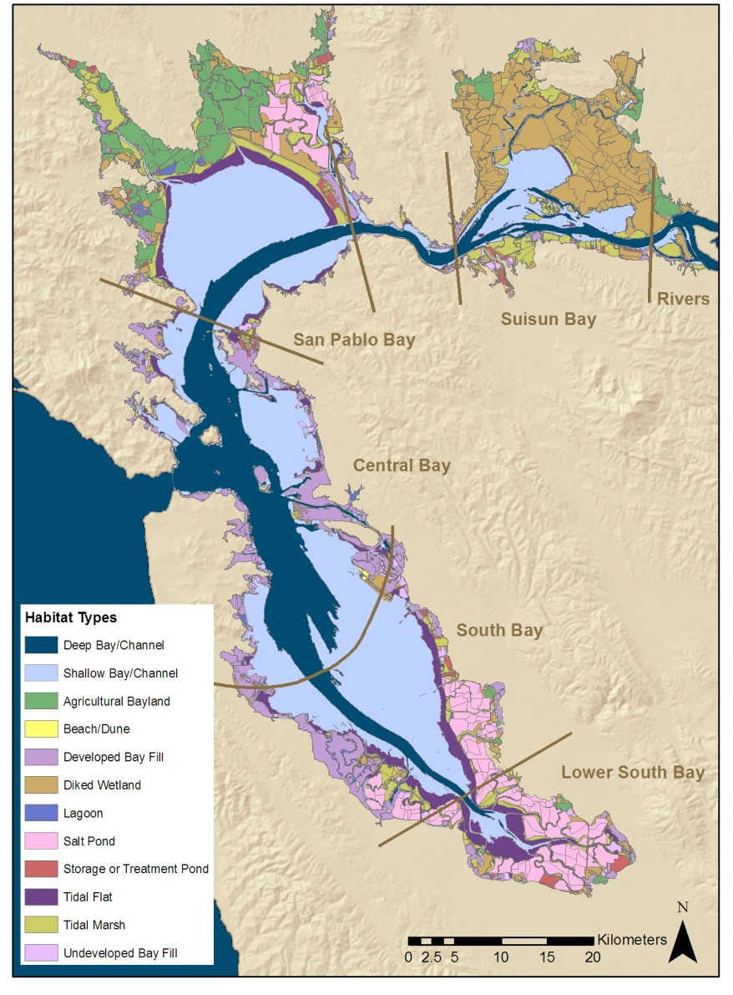
Overall, subtidal habitat dominates SF Bay, though not necessarily in all Bay Segments

Slide 26
Conceptual Model: Linking Nutrients, Ecological Response, & Beneficial Uses
Co-factors modulate ecological response
Notes:
Past guidance to states from EPA on nutrient criteria development was based on a percentile of the distribution of ambient nutrient concentration data
The problem with this is that the ambient nutrient concentrations can often be the residuals of what the aquatic plants have already taken up…so you often have a lack of correspondence between concentration, symptoms of eutrophication and effects on beneficial uses
As a results, many states and California have discarded this approached in favor of one that more directly relates to beneficial uses.

Slide 27
Estuarine NNE Framework:
Candidate Indicators
Primary Producers Indicators
Phytoplankton
Macroalgal biomass
Submerged aquatic vegetation
Microphytobenthos (MPB)
Physiochemical Indicators
Dissolved oxygen
Ammonia, urea
Water clarity
Toxic metabolites (HAB toxins)
Sediment organic matter accumulation
Benthic/pelagic metabolism
Consumer Indicators
Benthic macro-invertebrates
Notes:
These indicators are candidates only based on our evaluation of the literature. Selected based on established ties to nutrient impairment and the practicality of their implementation. Not all of these indicators may make the final cut.
See document for literature review.

Slide 28
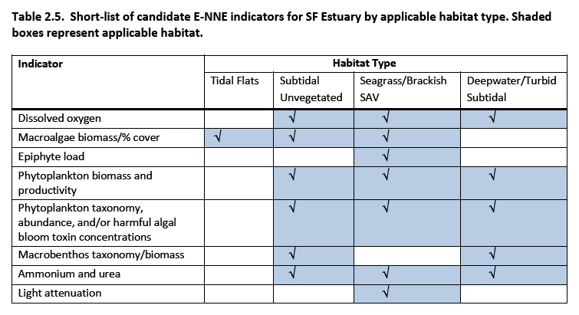
Short List of Candidate Indicators, Based on TAT Review

Slide 29
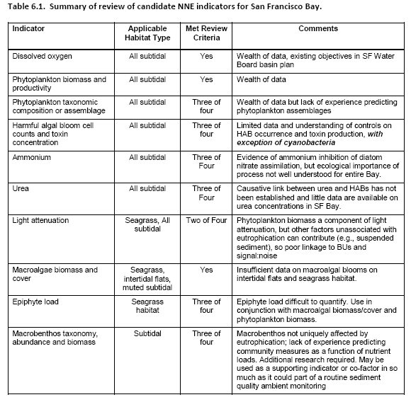
Summary of Review:
Dissolved Oxygen and Phytoplankton
Do you agree with our assessment of whether these indicators met review criteria?

Slide 30
Summary of Review:
Ammonium, Urea and Light Attenuation
Do you agree with our assessment of whether these indicators met review criteria?

Slide 31
Summary of Review:
Macroalgae, Epiphyte Load, & Macrobenthos
Do you agree with our assessment of whether these indicators met review criteria?

Slide 32
Distinction Among Indicator Categories: Primary, Supporting, and Co-Factors
Primary indicator: met all four review criteria, high level of confidence in using to assess eutrophication, intent to develop numeric thresholds in near term
Supporting indicator: did not meet all review criteria, supporting line of evidence, with experience
Co-factor: helpful for interpretation of primary and supporting indicators and could be included in monitoring program; will not be included in assessment framework

Slide 33
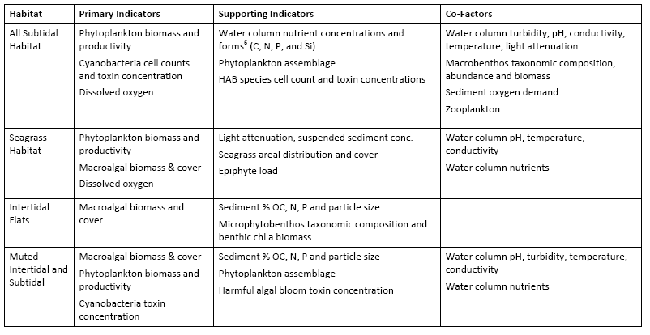
Designation of Primary and Supporting Indicators for SF Bay: All Subtidal
Do you agree with our designations of primary versus supporting indicators?

Slide 34
Designation of Primary and Supporting Indicators for SF Bay: Seagrass & Brackish SAV
Do you agree with our designations of primary versus supporting indicators?

Slide 35
Designation of Primary and Supporting Indicators for SF Bay: Intertidal Flats
Do you agree with our designations of primary versus supporting indicators

Slide 36
Designation of Primary and Supporting Indicators for SF Bay: Tidally Muted
Do you agree with our designations of primary versus supporting indicators?

Slide 37
Review of Candidate Indicators for the Estuarine NNE
Four Questions:
What are the appropriate indicators to assess eutrophication in SF Bay?
What is the status/trends of eutrophication in SF Bay, with emphasis on primary indicators?
What data are available to summarizing nutrient loading to SF Bay?
What are the data gaps and next steps required to develop an NNE framework for SF Bay?

Slide 38
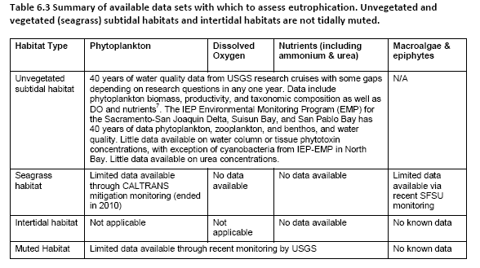
Data Available to Make Assessment of Eutrophication

Slide 39
Data Availability: Phytoplankton Biomass
  USGS data: 1977 – present (with some gaps – e.g. N. Bay from 1980-87) at 39 stations on the axis
  SFSU data: Pier assessments every 6 mins, North Bay research studies

Slide 40
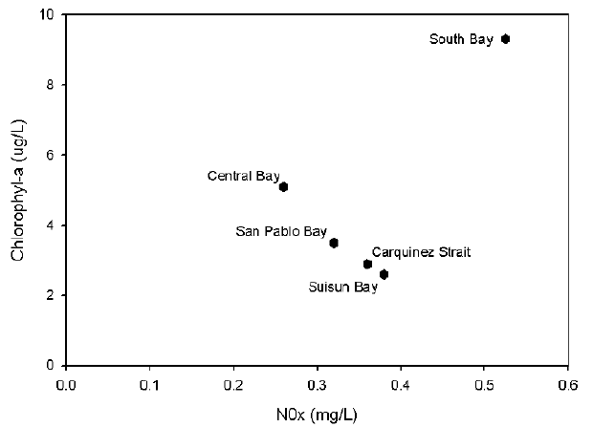
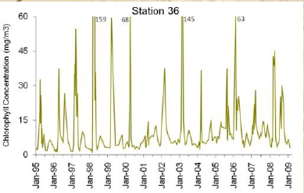
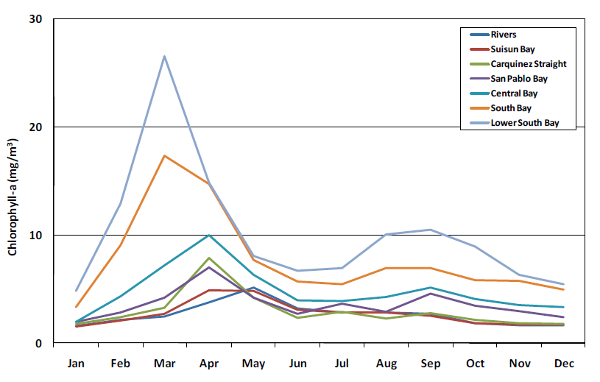
Status and Trends: Phytoplankton Biomass
Biomass is low relative to nutrient-enriched status
Baseline biomass increasing- annual mean increasing 3-5% yr⁻¹
Most blooms develop on the shoals and spread to the axis
Productivity is highest in the South Bay, moderate in the Central Bay, lower in San Pablo Bay and lowest in Suisun Bay
Spring bloom but fall blooms now also

Slide 41
Phytoplankton Assemblage
What are the data available to make an assessment?
  No systematic data collection
  But several research papers e.g.:
    Cloern and Dufford, 2005 assessment of phytoplankton taxa (500 species)
What do these data say with respect to status and trends?
  20 species make up >90% of the biomass
  Diatoms as a group make up 81% of the biomass
  Large cells make up 40% of the biomass
  No data to assess assemblage trends

Slide 42


Harmful Algal Blooms Cell Counts / Toxin Concentrations
What are the data available to make an assessment?
  No systematic data collection
  But a number of research papers e.g.:
    Cloern and Dufford (2005) study of phytoplankton taxa
    Lehman and others 2003, 2005, 2008 N. Bay and Delta cyanobacteria (Microcystis aeruginosa)
Microcystis
Heterosigma akashiwo

Slide 43
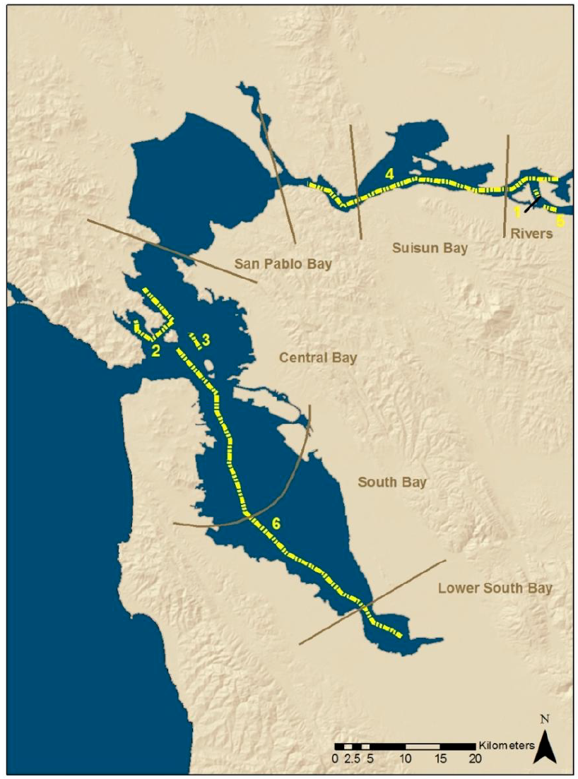
Status and Trends: HAB Species Cell Counts / Toxin Concentrations
SF Bay dominated by large celled diatoms - few HABs
Microcystis blooms in Delta and North Bay Jul-Nov since 1999
Red tide Heterosigma akashiwo C. Bay seeded from outside Golden Gate
Red tide Akashiwo sanguinae in S. Bay reached 200 μg/L chl.-a, reduced NH4 &NOx very low, seeded outside Golden Gate

Slide 44
Data Availability: Dissolved Oxygen
  USGS data: 1971 – present (with some gaps – e.g. S. Bay from 1980-92) at 39 stations on the axis
  SFSU spring/summer research program in the N. Bay
  Various other research papers over the last several decades

Slide 45
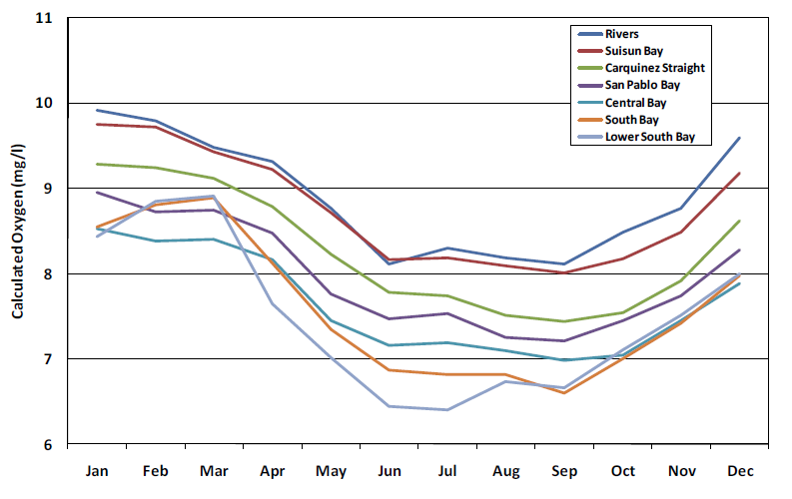
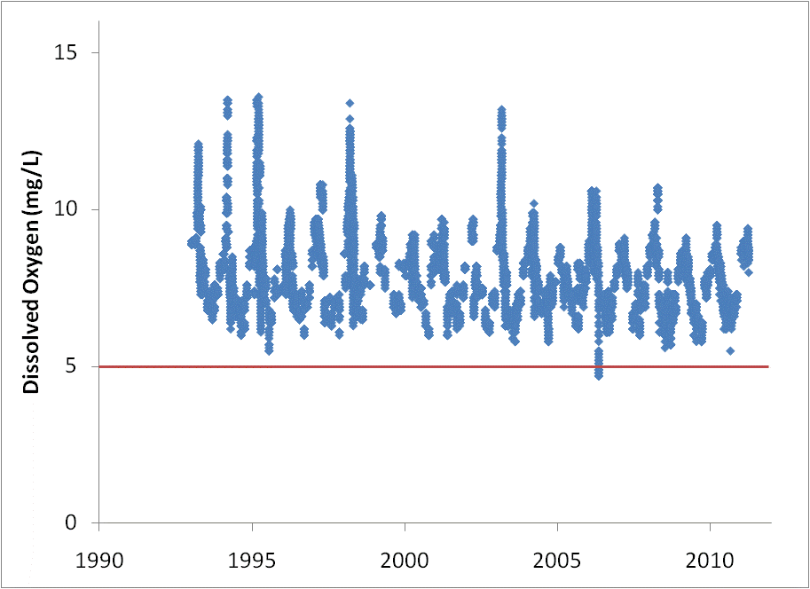
Status and Trends: Dissolved Oxygen
Prior to wastewater treatment upgrades, lower DO each summer and near zero after treatment plant failures
Today, oxygen concentrations mostly meet existing DO basin plan objectives
Oxygen concentrations are lowest during the summer at all stations
Low DO water occurs in some salt ponds
Bottom water DO decreasing 1.5-2.5% per decade Suisun, San Pablo and S. Bay

Slide 46
Macroalgal Biomass and Cover
What are the data available to make an assessment?
  There is no regular program of observation in SF Bay
  A limited survey of macroalgal abundance in seagrass beds is slated for Spring 2011
What do these data say with respect to status and trends?
  Survey published in 1985 identified 162 species, with four dominant common
  Occurs on hard substrate – but found with lesser diversity on mud and salt flats, e.g. rafting mats on eelgrass
  Highest biomass abundance in the summer (May-Sep)

Slide 47
Water Column C, N, P, Si
What are the data available to make an assessment
  Abundant data from USGS research program: 1968 – present at up to 39 stations per year on the axis
  Data on urea is limited to a few research studies
What do these data say with respect to status and trends?
  Concentrations high in winter lower in summer
  Concentrations of NOx highest in the S. Bay followed by Suisun, San Pablo and lowest in Central Bay
  Slight decrease in NOx concentrations over time in the S. Bay

Slide 48
Status and Trends: Summary
SF Bay atypical among other nutrient-enriched estuaries
  Low phytoplankton biomass indicates that productivity controlled by factors other than simple nutrient limitation
Evidence that historic resilience to nutrient enrichment is decreasing
  Statistically significant decrease in DO, increase in phytoplankton biomass
Insufficient data on macroalgae (intertidal flats and seagrass), HAB species cells counts and toxins to make an assessment

Slide 49
Review of Candidate Indicators for the Estuarine NNE
Four Questions:
What are the appropriate indicators to assess eutrophication in SF Bay?
What is the status/trends of eutrophication in SF Bay, using these indicators?
What data are available to summarize nutrient loading to SF Bay?
What are the data gaps and next steps required to develop an NNE framework for SF Bay?

Slide 50
Nutrient Sources and Pathways
True sources
  e.g. fertilizers, food supply for humans and animals, mineralization, mineral weathering (P), atmospheric nitrogen and N fixation (N), combustion, pet wastes
Pathways
  Atmospheric Deposition
  Storm water (Central Valley and municipal)
  Waste water (Municipal and industrial)
  Groundwater
  Ocean exchange (net)

Slide 51
Available Loads Data
Source or Pathway | Relative Load | Comment | New data available to make suitable estimates?
Atmospheric Deposition | Small | Outdated | Yes, literature from other coastal cities
Terrestrial Loads from the Delta | Large | Outdated, uncertain | Yes for low flow, arm wave for high flow. New USGS Sparrow model next year
Municipal Wastewater | Moderately large | Outdated, uncertain | Yes, for perhaps half the facilities (with some collation effort), for recent years, spotty data for some analytes
Industrial Wastewater | Very small | Outdated | Maybe
Municipal Storm Water | Moderately large | Previous estimate bad, uncertain flows | Yes, a little
Groundwater | Moderately small for N, small for P | No previous estimates | Yes
Pacific Ocean net exchange | Could be large during dry season for organic N and P | Very uncertain | No

Slide 52
Can Status and Trends be Determined?
Presently Available Data Are of Poor Quality
  Speciation is poorly understood
    Organic versus inorganic forms
  Temporal variation cannot be resolved
    Within year (e.g. summer versus winter)
    Between years (wet versus dry) or over time
  Spatial variation cannot be resolved
    North Bay versus south Bay
    Exchange between Bay segments and the ocean

Slide 53
Recommendations
Source | Recommended Next Steps
Atmospheric Deposition | Synthesize coastal cities data and newly available N deposition via models. Collect local wet and dry N and P deposition over 1-2 yr period.
Terrestrial Loads from Delta | Analyze of existing RMP data to estimate dry season nutrient loads. Sparrow Model Initiate wet weather sampling at the DWR gauge at Mallard Island.
Municipal Effluent | Synthesize existing data to estimate loads over period of last 10-20 years. Encourage more data collection at POTWs and inter-lab comparison.
Industrial Effluent | Synthesize available data
Stormwater | Synthesize data to provide an updated estimate of stormwater contributions to assist prioritization of next steps. Scope the data needs for development of a dynamic watershed loading model.
Groundwater | Refine current loads estimates after review of local USGS groundwater experts.
Exchange with Coastal Ocean | Initiate a workgroup of local experts to design a sampling program for nutrient flux at the Golden Gate boundary, with the intent of developing a hydrodynamic and material flux dynamic model to describe exchange with coastal ocean.

Slide 54
Review of Candidate Indicators for the Estuarine NNE
Four Questions:
What are the appropriate indicators to assess eutrophication in SF Bay?
What is the status/trends of eutrophication in SF Bay, using these indicators?
What data are available to summarize nutrient loading to SF Bay?
What are the data gaps and next steps required to develop an NNE framework for SF Bay?

Slide 55
Specified Data Gaps and Next Steps
Guidelines for discussion
Data gaps and recommendations are a laundry list –no attempt to prioritize
Express your opinion on relative importance, but we won’t try to get your consensus on priorities (YET)
Missing data gaps?
Missing next steps?

Slide 56
Four Types of Data Gaps and Recommended Next Steps
Develop and implement an NNE assessment framework for the Bay
Develop & use models to link NNE response indicators to nutrient loads and other management controls
Develop & implement monitoring program to support regular NNE assessments of SF Bay and validate the load –response models
Coordinate SF Bay NNE workplan with nutrient management in Delta

Slide 57
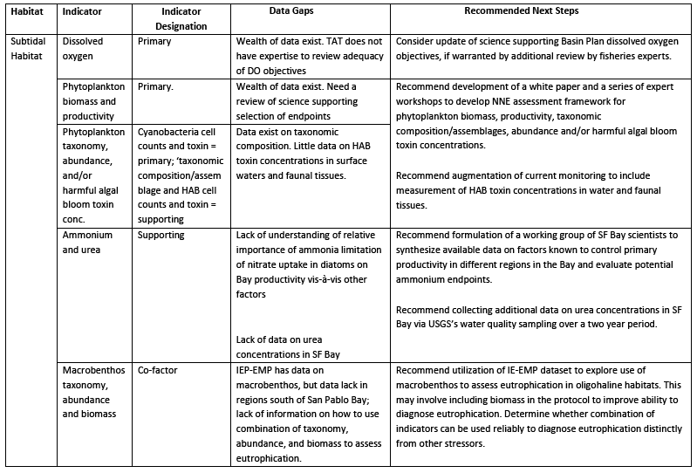
Data Gaps and Next Steps:
Primary Indicators in Subtidal Habitat
What do you think of the identified data gaps and recommended next steps?
Notes:
Steve –The Science Advisory Board will operate independently from the Technical team and will review adequecy of science and how it is used in policy. The Science Advisory Board will be composed of 3-4 nationally recognized experts. Formation of the Board will occur in the springtime, timed with delivery of technical products to review.

Slide 58
Data Gaps and Next Steps: Supporting & Co-factors Indicators in Subtidal Habitat
What do you think of the identified data gaps and recommended next steps?
Notes:
Steve –The Science Advisory Board will operate independently from the Technical team and will review adequecy of science and how it is used in policy. The Science Advisory Board will be composed of 3-4 nationally recognized experts. Formation of the Board will occur in the springtime, timed with delivery of technical products to review.

Slide 59
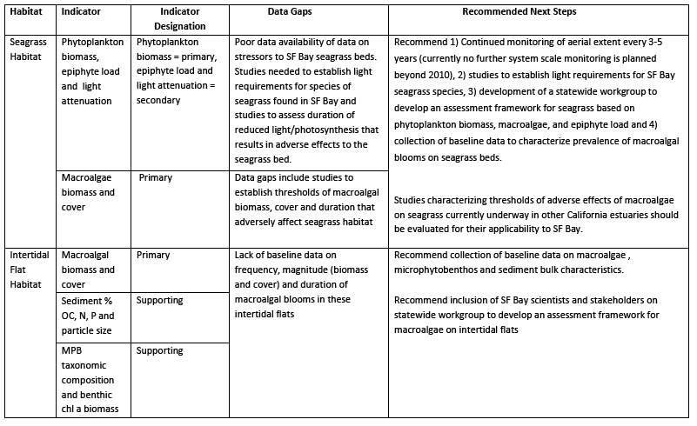
Data Gaps and Next Steps: Primary and Supporting Indicators in Seagrass Habitat
What do you think of the identified data gaps and recommended next steps?
Notes:
Steve –The Science Advisory Board will operate independently from the Technical team and will review adequecy of science and how it is used in policy. The Science Advisory Board will be composed of 3-4 nationally recognized experts. Formation of the Board will occur in the springtime, timed with delivery of technical products to review.

Slide 60
Data Gaps and Next Steps: Primary and Supporting Indicators in Intertidal Flat Habitat
What do you think of the identified data gaps and recommended next steps?
Notes:
Steve –The Science Advisory Board will operate independently from the Technical team and will review adequecy of science and how it is used in policy. The Science Advisory Board will be composed of 3-4 nationally recognized experts. Formation of the Board will occur in the springtime, timed with delivery of technical products to review.

Slide 61
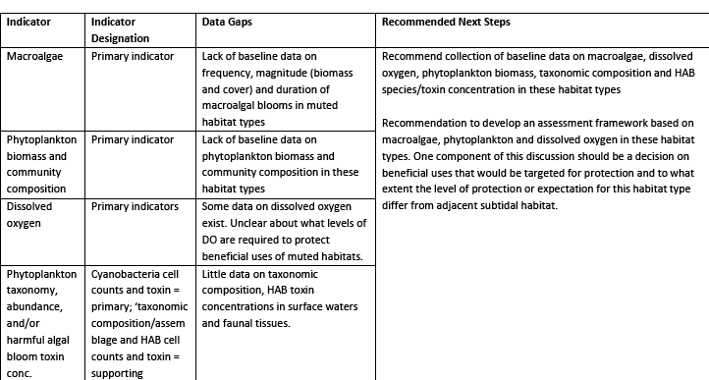
Data Gaps and Next Steps: Primary and Supporting Indicators in Tidally Muted Habitat
What do you think of the identified data gaps and recommended next steps?
Notes:
Steve –The Science Advisory Board will operate independently from the Technical team and will review adequecy of science and how it is used in policy. The Science Advisory Board will be composed of 3-4 nationally recognized experts. Formation of the Board will occur in the springtime, timed with delivery of technical products to review.

Slide 62
Four Types of Data Gaps and Recommended Next Steps
Develop and implement an NNE assessment framework for the Bay
Develop & use models to link NNE response indicators to nutrient loads and other management controls
Develop & implement monitoring program to support regular NNE assessments of SF Bay and validate the load –response models
Coordinate SF Bay NNE workplan with nutrient management in Delta

Slide 63
Development of Load-Response Models
Components
Assessment and models of nutrient loading from various sources
Models of NNE indicator response to loads

Slide 64
Nutrient Loads to SF Bay:
What Are The Sources?
Atmospheric Deposition
Terrestrial Loads from Delta
Municipal Effluent
Industrial Effluent
Stormwater
Groundwater
Exchange with Coastal Ocean

Slide 65
Nutrient Load Data Gaps and Next Steps: Atmospheric Deposition, Loads From Delta, & Municipal Effluent

Slide 66
Nutrient Load Data Gaps and Next Steps:
Industrial Effluent, Stormwater, Groundwater & Exchange with Coastal Ocean

Slide 67
Development of Load-Response Models: Chesapeake Bay Example
Two Types:
Air, oceanic, and watershed loading model
• Estuary water hydrodynamic and water quality model

Slide 68
Air, Oceanic and Watershed Loading Model
Four components:
Hydrologic sub-model
Non-point source sub-model
River sub-model which routes flow and associated nutrient loads to the Estuary
Ocean exchange model

Slide 69
Estuary Hydrodynamic & Water Quality Model
Two subcomponents:
Hydrodynamic sub-model that simulates the mixing of waters in the Estuary
Water quality sub-model(s) to simulate Estuary’s response of NNE indicators to nutrient loads and other co-factors (light, temperature, grazing, etc.).

Slide 70
Recommendations to Develop Models
Substantial data and resources required to develop precise models
  May make sense to develop simpler models in short-term, more complex over long term
Two near-term recommendations:
  Synthesize existing data on loads, identify priority loads to collect additional data
  Conduct workshop to develop modeling strategy

Slide 71
Four Types of Data Gaps and Recommended Next Steps
Develop and implement an NNE assessment framework for the Bay
Develop & use models to link NNE response indicators to nutrient loads and other management controls
Develop & implement monitoring program to support regular NNE assessments of SF Bay and validate the load –response models
Coordinate SF Bay NNE workplan with nutrient management in Delta

Slide 72
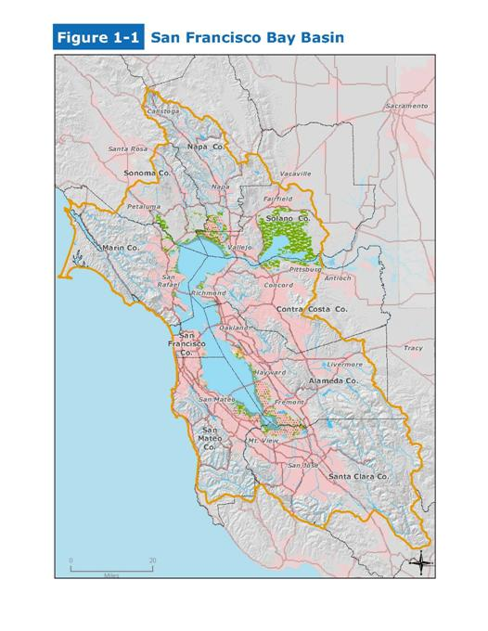
Development & Implement Monitoring Program
USGS program is research, does not replace need for regular monitoring program
Two program components
  Core program– NNE and loads assessment
  Special studies – develop and validate models

Slide 73
Four Types of Data Gaps and Recommended Next Steps
Develop and implement an NNE assessment framework for the Bay
Develop & use models to link NNE response indicators to nutrient loads and other management controls
Develop & implement monitoring program to support regular NNE assessments of SF Bay and validate the load –response models
Coordinate SF Bay NNE workplan with nutrient management in Delta

Slide 74
What Do You Think of the Specified Data Gaps and Next Steps?
Guidelines for discussion
Data gaps and recommendations are a laundry list –no attempt to prioritize
Express your opinion on relative importance, but we won’t try to get your consensus on priorities
Missing data gaps?
Missing next steps?
ADDITIONAL COMMENTS?

Slide 75
Meeting Goals
Discuss criteria for selection of Science Advisory Panel members and provide feedback on candidates
Provide feedback on SF Bay NNE literature review and data gaps report
Provide input on scope for SF Bay NNE workplan
Notes:
RIK

Slide 76
Timeframe for Work Plan Development
SF Bay NNE Workgroup
SF Bay RMP Nutrient Strategy
Draft lit. review
SAG feedback
Finalize lit. review
Outline of workplan
Draft workplan
Final workplan
April 2011
June 2011
Aug 2011
Oct 2011
Dec2011
RMP Nutrient Strategy Workshop
RMP Nutrient Strategy meetings
Draft RMP Nutrient Strategy?
Timeline presumes strong nexus between NNE and RMP Nutrient Strategy? Are you comfortable with this?

Slide 77
Discussion on Development of Workplan
Work Plan Components
Identify and prioritize work elements
  Phasing
Identify key institutions, programs and roles
  E.g. USGS monitoring, RMP
Identify potential funding sources
Linkage with nutrient management issues in Delta
Notes:
Steve –The Science Advisory Board will operate independently from the Technical team and will review adequecy of science and how it is used in policy. The Science Advisory Board will be composed of 3-4 nationally recognized experts. Formation of the Board will occur in the springtime, timed with delivery of technical products to review.

Slide 78
Wrap Up and Next Steps
Next SF Bay SAG Meeting – Early July
  Final literature review release
  Discuss strawman outline for workplan
  Planning for work plan development vis-à-vis RMP strategy
Notes:
Steve –The Science Advisory Board will operate independently from the Technical team and will review adequecy of science and how it is used in policy. The Science Advisory Board will be composed of 3-4 nationally recognized experts. Formation of the Board will occur in the springtime, timed with delivery of technical products to review.

Slide 79
Comments? Questions?
Notes:
Steve –The Science Advisory Board will operate independently from the Technical team and will review adequecy of science and how it is used in policy. The Science Advisory Board will be composed of 3-4 nationally recognized experts. Formation of the Board will occur in the springtime, timed with delivery of technical products to review.

